Slide 1

DHOLE PATIL COLLEGE OF ENGINEERING, PUNE. DEPARTMENT OF MECHANICAL ENGINEERING
B.E. Mechanical
Project Stage-II
“Analysis of Thrust Generated Using Electric Propulsion (EP)”
By
Mr. Pawan Vyas [B150600924]
Mr. Ameya Vaidya [B150600919]
Mr. Kshitij Sontakke [B150600901]
Under the guidance of
Prof. Anantharama
DEPARTMENT OF MECHANICAL ENGINEERING
YEAR 2021-22

Slide 2
ACKNOWLEDGEMENT
We have taken efforts to describe electric propulsion in this project. However, it would not have been possible without the kind support and help of many individuals. we would like to extend my sincere thanks to all of them. It has been great honor and privilege to undergo guidance of prof. Anantharama, we are highly in debt to prof. Vikram Avahad for his guidance and constant supervision as well as for providing necessary information regarding the project and also for his support in completing the project. Their constant guidance and willingness to share their vast knowledge made us understand this project and its manifestations in great depths and helped us to complete the assigned tasks on time. Our thanks and appreciations also go to our colleagues in developing the project and people who have willingly helped us out with their abilities.

Slide 3
ABSTRACT:
This is a presentation and review about Electric Propulsion(E.P.) which is used in spacecraft and satellites technologies and also is in heavy research and development for its use on earth.
Ion thrusters are the most developed electric engines intended for propelling large spacecraft during in-space maneuvers, offering the highest efficiencies at reasonable power and thrust levels.
This project first explains about the basics of Electric Propulsion, and thrust, efficiency when compared with chemical fuel.
Our project demonstrates the potential of ion engines for current and future application, and gives us a basic view of launch cost savings using electric propulsion.

Slide 4
Objective of The Project:
To show the working of electric propulsion on Earth’s atmosphere.
To study, give ideas and add values to the present research done on the present scenario of Electric Propulsion.
A detailed study about the thrust generated by Electric Propulsion under different conditions.

Slide 5
METHODOLOGY:
This project falls under methodology of analytical research, this approach was taken because project is based on analysis of ion propulsion technology.
We started with doing extensive research on the technology and came to conclusion to setup an experimental setup that can demonstrate ionic properties under earth’s atmosphere
This experiments uses Wimshurst machine and Leyden jars to generate high voltage without much of effort.
Iono craft and moving and blowing of a lit candle flame is the main demonstration of the project.
In conclusion it was found that current generation ion thrusters are not capable to produce significant thrust for initial take off.

Slide 6
INTRODUCTION: What Is Electric Propulsion?
Electric Propulsion(EP) is a class of space propulsion which makes use of electrical power to accelerate a propellant different possible electrical or magnetic means.
Unlike Chemical systems, electric propulsion requires very little mass to accelerate a spacecraft.
Electric propulsion when compared with chemical propulsion is not limited in energy, but is only limited by the available electric power on-board spacecraft.
NASA identified electric propulsion as a prime enabling technology for
future space exploration missions, space travel.
Electric propulsion are intended to reduce fuel weight, decrease travel times to other planets

Slide 7
What Is An Ion Thruster?
An ion thruster is a form of electric propulsion used for spacecraft propulsion. It creates thrust by accelerating ions using electricity.
An Ion thruster ejects ion instead combustion gases to produce thrust.
An ion thruster ionizes a neutral gas by extracting some electrons out of atoms, creating a cloud of positive ions.
These ion thrusters rely mainly on electrostatics as ions are accelerated by the Coulomb force along an electric field.
Ion thruster must be operated for a long time for the spacecraft to reach its top speed.
Spacecrafts powered by these thrusters can reach speeds upto 90,000m/s.

Slide 8
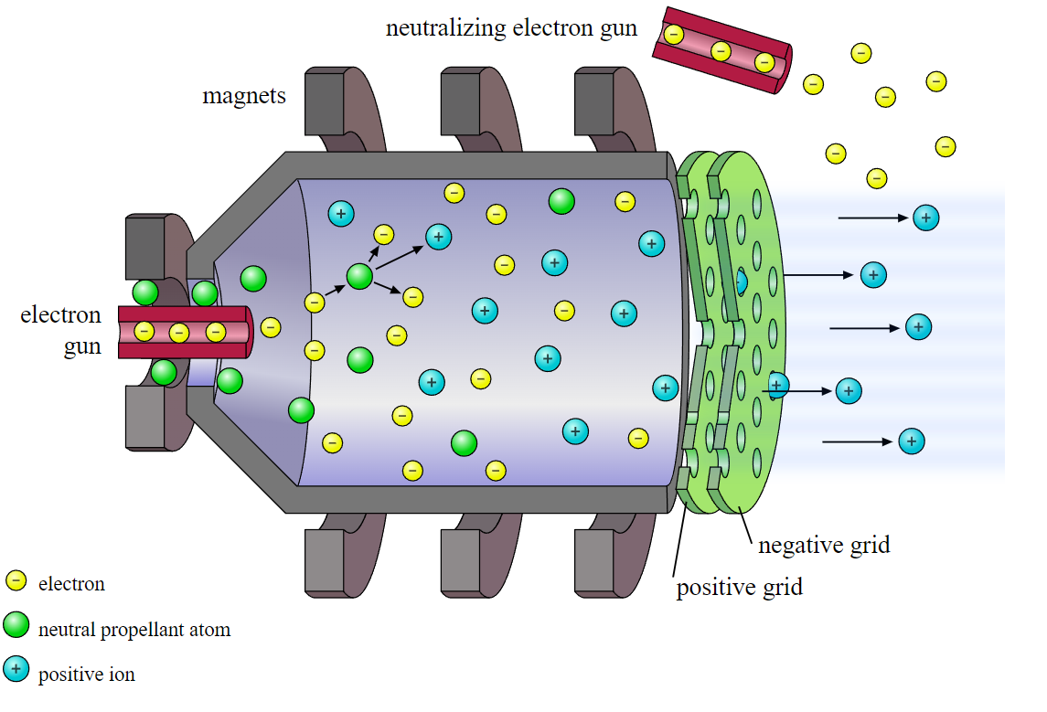
Thruster used for EP in Space(Vacuum):
As there is vacuum in space there is need for a propellant to generate thrust.
Noble gases are used because of their neutral nature.
Hence, Xenon is used.
Xenon is used among the other noble gases because it has high atomic mass which helps to generate more thrust.
ION THRUSTER

Slide 9
LITERATURE REVIEW
Sr No | Name of Author | Title of the Paper | Work Carried out | Work Carried out
1 | K.HOLSTE, P. DIETZ, K.KIEL, S. SCHARMANN | Ion thrusters for electric propulsion:- Scientific issues developing a niche technology into a game changer | 18 may 2020 & Creative Commons Attribution | Research heavily leaned on electric propulsion system and provides alternative for current existing hall thrusters and does same for propellants
2 | Stephane Mazouffre (university of Orleans) | Electric propulsion for satellites and spacecraft: established technologies and novel approaches | Published on 6th April 2016 | Uses of Electric propulsion in space crafts for outer space missions and exploring the universe.

Slide 10
Sr No | Name of Author | Title of the Paper | Work Carried out | Publication Details
3 | NASA | Ion Propulsion | 11th January 2016 | Working of Ion Thrusters
4 | Carlos Sánchez Lara | Design and Performance Analysis Study of an Ion Thruster | 22nd June, 2016 & Polytechnic University of Catalonia | Design analysis of ion thruster and in depth discussion on range of the machine and efficiency
5 | Tanzim Kawnine and Maria Kawnine | Short Review on Electric Propulsion System: Ion Thruster | 24 August 2014 & ResearchGate publication | suitable and efficient alternative to conventional propulsion systems. With very low demand on fuel due to very high specific impulse generation, ion thrusters can easily compete with chemical propulsion systems

Slide 11
What Is Wimshurst Machine?
James Wimshurst (1832 - 1903) was an English naval engineer and inventor who worked intensely on electricity and its generation. His electrostatic generators, which he developed after 1880, were the first to offer the possibility of continuous currents at a very high voltage. These were needed for the first X-ray machines, for example .It is a very efficient instrument that converts mechanical energy (counterrotating segment discs) into static electricity and stores it. The voltage is induced by separation of negative and positive charges, which is achieved by electrostatic induction. The charges are stored in Leyden jars (named after the Dutch city of Leyden) and is dissipated by sparks or arcing between the spherical electrodes. This machine is called as Wimshurst machine
High voltage supply is essential for the analysis of the Electric Propulsion experimental set up. After a quite a bit of research about high voltage generator, we came across a high Voltage electro-static generator called as Wimshurst Machine.

Slide 12
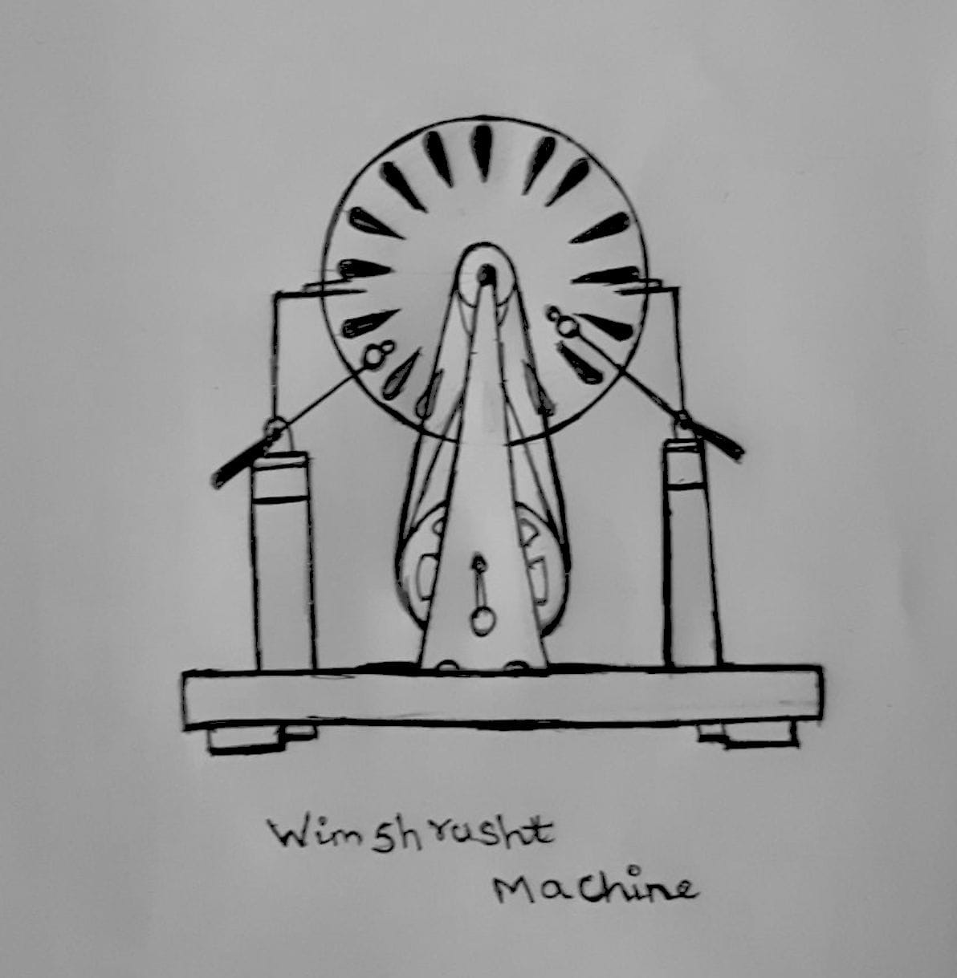
Rough Sketch:
For achieving success in the project, there was a requirement of high voltage producing system.
After a lot of research a system called Wimshurst machine is taken into the consideration.
Wimshurst machine is an electrostatic generator which helps to generate high voltage.
This machine will help to show the thrust which is generated by the ions by using various components like a ion-copter, rotor blades etc.

Slide 13
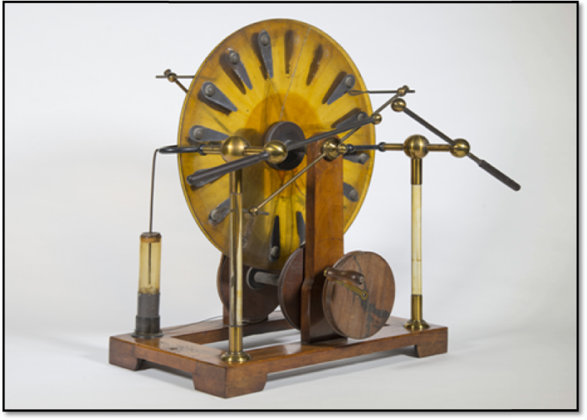
Parts Of Wimshrusht Machine:
Components used in Wimshurst machine:
Acrylic Plates
Aluminium Sheets
Wooden Ply
Copper Wires
Copper Electrodes
Plastic Jars
Elastic Belts
Aluminium Alloy Rods
Pulleys
Sofa legs
Actual Wimshurst machine

Slide 14
Wimshurst electrostatic generator Calculations:
There are in total 4 pulleys which are used, out of the four 2 are used on the driving shaft and the other 2 driven pulleys are attached to the acrylic disk plate. Both the sets of driving and driven pulleys are connected with the elastic belt, one elastic belt is connected normally another is given a loop. This will make disk rotate in opposite direction.
The diameter of the driving pulleys (d₁) = 100mm
The diameter of the driven pulley (d₂) = 20mm
To find the rotation that the driven pulley will make when the driving the pulley will make a single turn:
d1*N1 = d2*N2

Slide 15
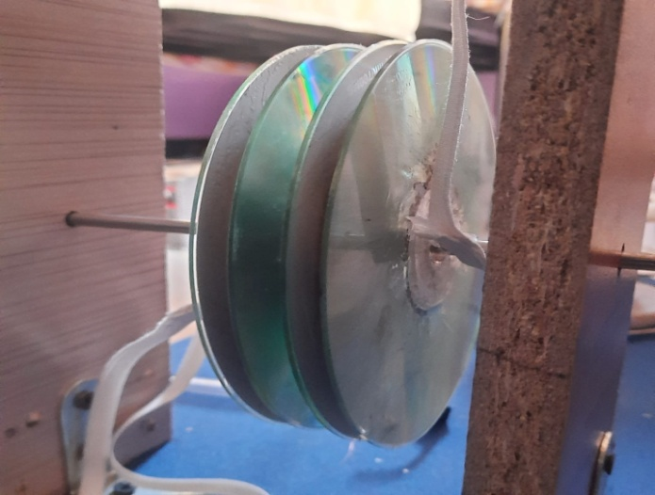
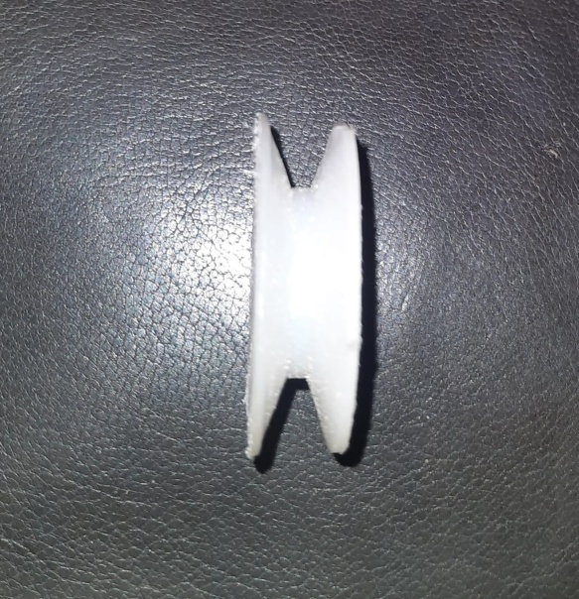
d1/d2 = N2/N1
N₁= speed of the driving pulley
N₂= speed of the driven pulley
100*1 = 20*N₂ …(considering a single rotation for driving pulley)
N₂ = 100/20
N₂ = 5
1*d₁= 5*d₂
Therefore, if the speed of the driving pulley is 30 r.p.m. then the speed of the
driven pulley will be 150 r.p.m.
Driving pulley
Driven pulley

Slide 16
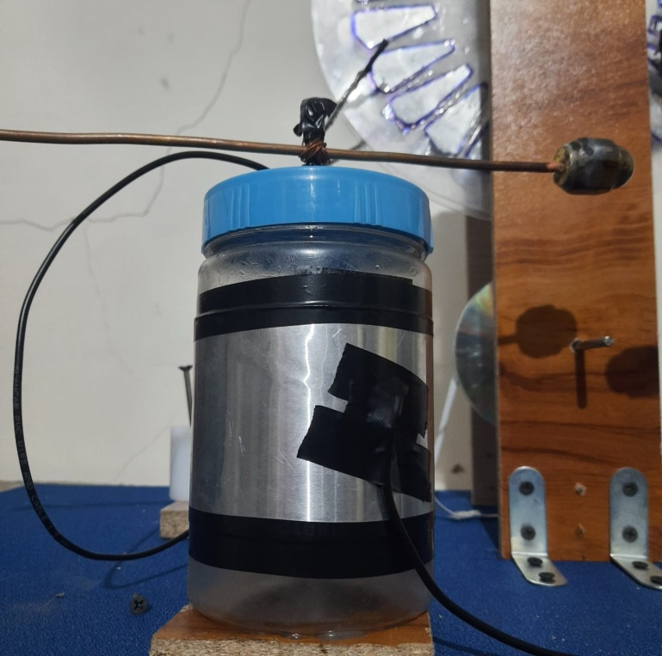
Charge Generated:
1cm gap = 10kV (estimated value)
Escape velocity of the oxygen ion required to escape the electric field:
First Ionization Energy of Oxygen = 13.6181eV
1e V = 1.602 x 10⁻¹⁹joules.
The corresponding capacitor voltages are
V = Q/C
V_{i} = Q_{O}/C_{i}.
Leyden Jar Capacitor

Slide 17
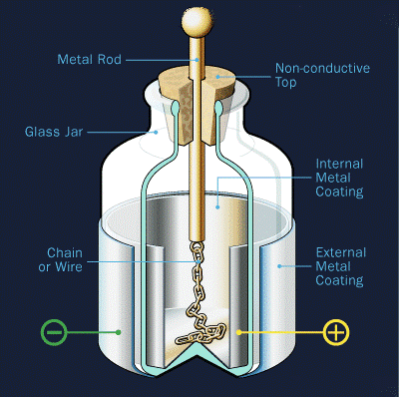
When the switch S closes the capacitors they stay in series and redistribute their charge. Their common voltage will become:
V = Q+Q_{O} / C+C_{i}
If C>>C_{i} the voltage increase will be:
V = Q_{O} / C
Typical Leyden jar of one pint size has a capacitance of 1nF
The Leyden jar we made is less that pint size. So the capacitance is
less than 1nF.
Leyden jar Capacitor

Slide 18
Ion Velocity Calculation:
Electron work equation:
-I + E = ½ mv²
I = amount of energy required to knock of electron. Constant Will be different for every element.
E = total amount of energy going into a system.
m= mass of the electron 9.01x10⁻³¹ kg
Momentum of the electron:
e⁻ =m/v

Slide 19
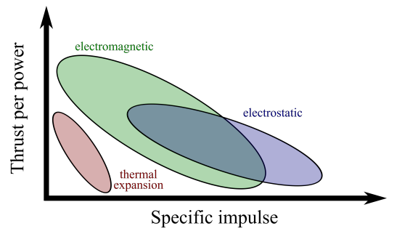
The three major types of acceleration schemes for electric propulsion in terms of thrust per power and specific impulse.
The Wimshurst machine gives high electrostatic charge which in return provides high specific impulse among other methods. It is not most thrust generating method but gives an idea what electric propulsion is capable of.

Slide 20
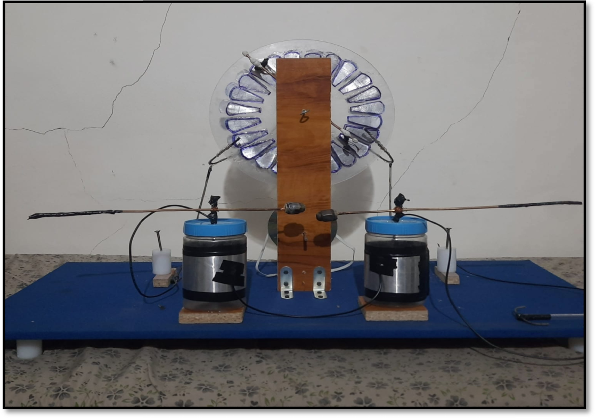
Experimental Setup:
The wheel spins, the positive charge will move towards the double ended brush on the other disk. When it aligns with this brush, it will induce a negative charge in the conducting plate directly across from it on the other disk. This negative charge will, in turn, cause a positive charge to appear on the plate on the other end of the brush.
The disks continue to spin, the original positive charge will reach the collecting combs on one side, and will then be stored in the Leyden jar capacitor. Meanwhile, the positive and negative charges on the other disk will be rotating in the other direction. When they line up with the double-ended brush on the opposite disk, they will induce a positive and negative charge on the conducting plates across from them.
Experimental set up of Wimshurst machine

Slide 21
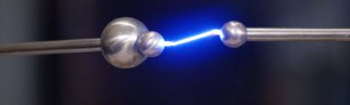
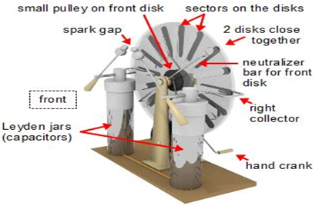
Those new charges will rotate until they align with the other double ended brush, inducing more charges, as the other ones reach the collecting combs and are stored. This cycle continues, with more and more charges being induced, and then stored, until it is discharged in the form of a spark! Then the whole cycle repeats.
Spark created in energy gap
Wimshurst components

Slide 22
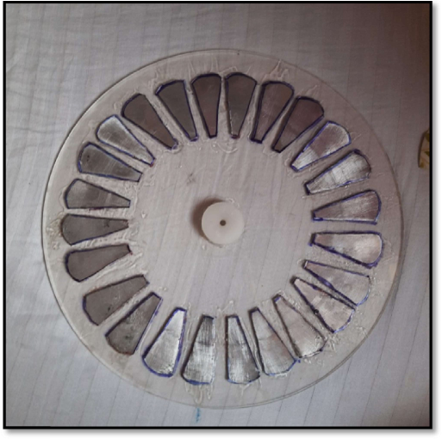
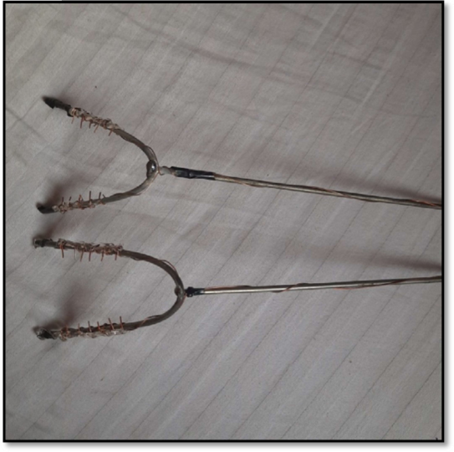
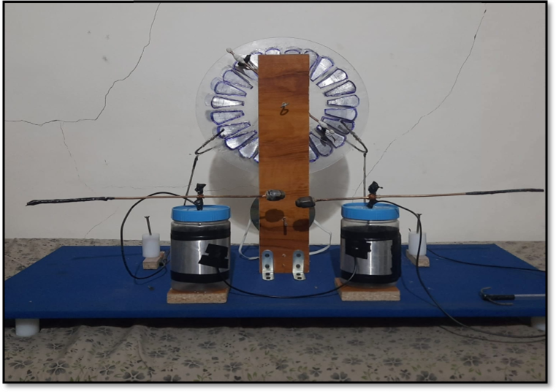
MAKING OF WIMSHURST MACHINE:
Acrylic disk with aluminium sectors
Collecting rods
Experimental setup of Wimshurst machine

Slide 23
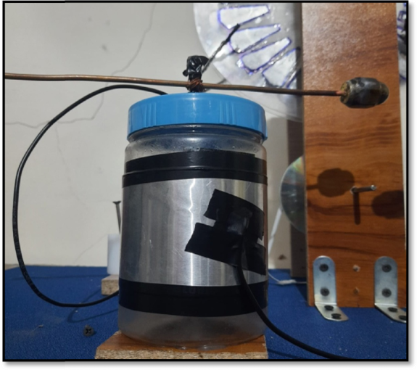
LEYDEN JARS:
Two plastic cylindrical containers were wrapped with aluminium sheets from inside and outside. A screw winded with copper is placed on the top of the jar which is connected with the collecting rods. The copper wire of the screw is in direct contact with the aluminium sheet of the container from inside. The Leyden jars are placed on the opposite side of the acrylic plates.
Leyden jars are basically a type if capacitors, made of plastic and wrapped with aluminium sheet of 70 mm on both inside and outside. The outer aluminium sheets are connected with copper wire to complete the circuit. The capacitors are connected in series.
Experiment setup of Leyden jar

Slide 24
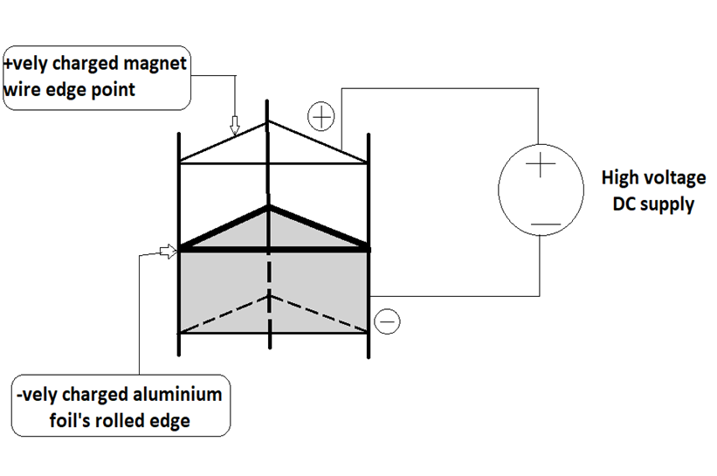
Small Scale Model For Representation Of Electric Propulsion:
The propulsion takes between positively charged point material towards curved negatively charged material when connected to a high voltage DC supply.
Here the weight of the model should be feather like to get the upward thrust against the Earth’s Gravitational pull.
Iono-craft model

Slide 25
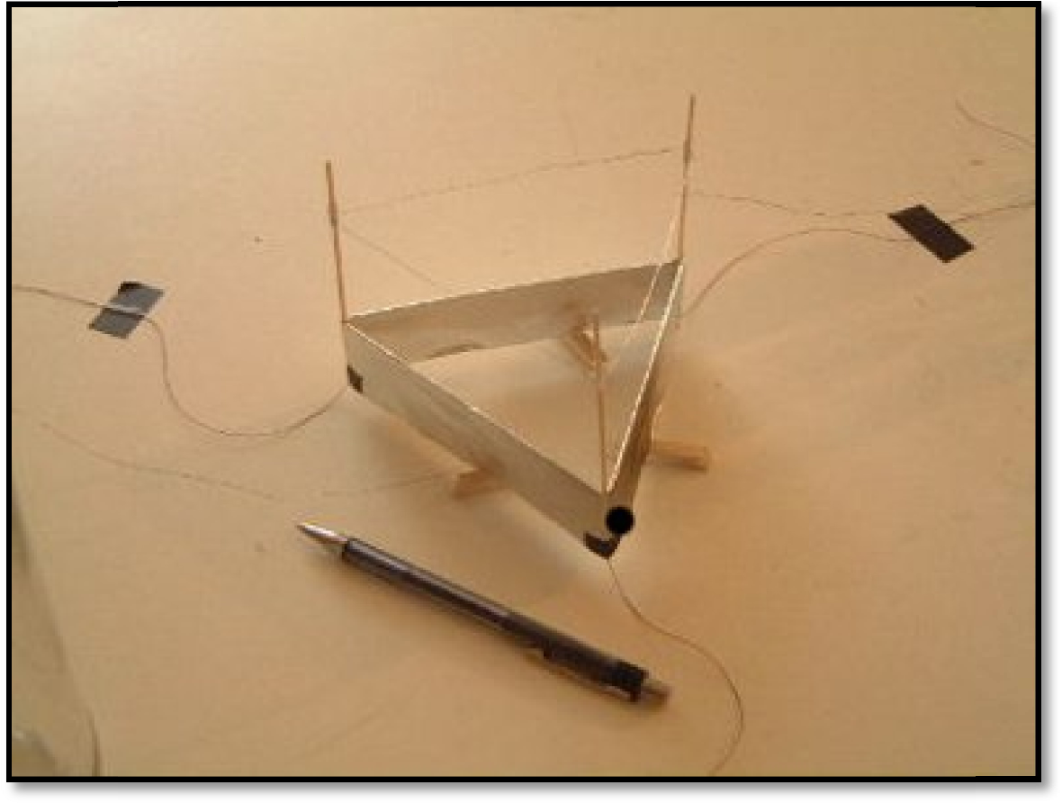
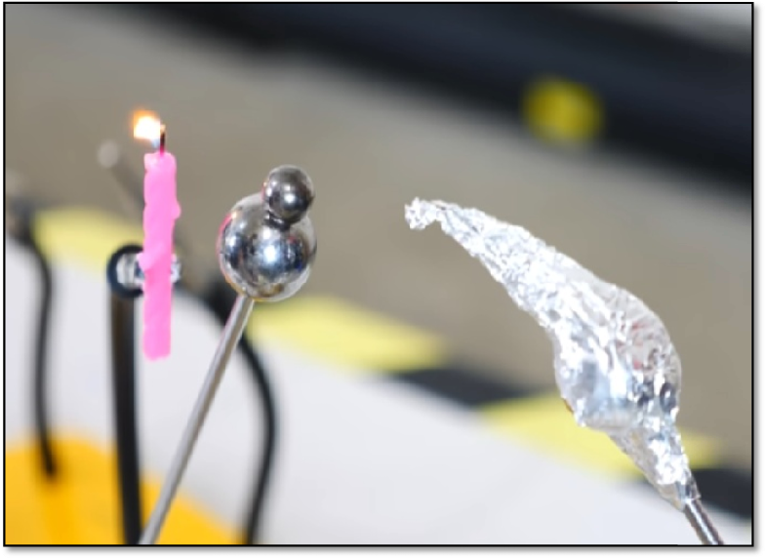
Ion Thrust Generation Experiment:
The propulsion takes between positively charged point material towards curved negatively charged material when connected to a high voltage DC supply. Here the weight of the model should be feather like to get the upward thrust against the Earth’s Gravitational pull. The Ion-Craft will have to a light weight as the initial thrust produced is very less. The ion craft will consist of a light stand, aluminium foil, copper wires, high voltage step up motor.
Iono craft
Candle experiment

Slide 26
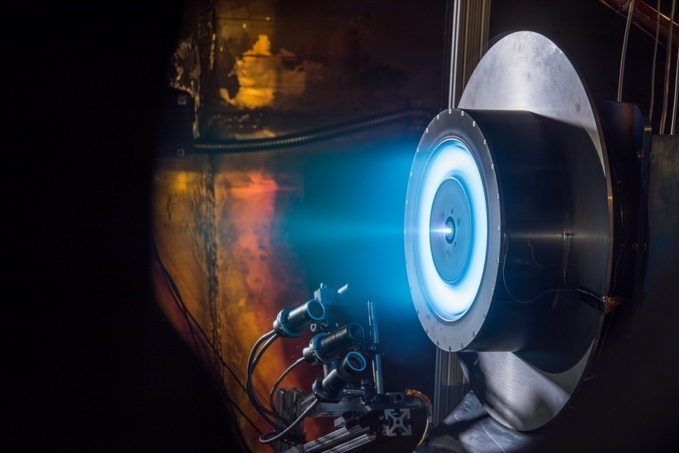
RESULT :
ADVANTAGES:
Success of Electric Propulsion on Earth’s atmosphere will help to increase the efficiency and safety of flights.
50-60% more efficient that regular fuel.
Complexity of the mechanical motors is highly reduced.
High thermal efficiency.
Highly reliable method.
Low maintenance.
Environmentally friendly.
Will make space travel easy and affordable.
Highest efficiency among the thrusters(>40)
X3 Ion Thrusters by Nasa.

Slide 27
DRAWBACKS:
Difficulties on Earth: The initial thrust produced is imperceptible, that means the drag produced by the air will easily cancel out the force produced by the thrusters.
Lack of technological advancements to convert the thrust for use in the earth’s atmosphere.
Low initial power Current ion thrusters can provide only 0.5Newtons of thrust, which is equivalent to force you would feel while holding a 5 rupee coin.
Costly: The cost is approximately 26 Crore. This uses four 25KW hall thrusters powered by 100KW electric system which gives combined thrust of just 6.6 newton for 33 days.
Xenon: It is a trace gas found in the earth’s atmosphere to the extent of about one part in 20 million, which makes it very rare. There are other alternative like krypton or cesium or iodine but they have their own set of problems.

Slide 28
APPLICATIONS:
Research and development of electric propulsion system in aircraft is being completed by many companies like Boeing, Airbus, NASA and is very close in terms of making a highly efficient Aircraft which uses Electric Propulsion
When used in an aircraft increases the safety, efficiency, passenger experience.
All the space research organizations around the globe use this technology in their space probes which are send for space expeditions.
Personal flying car is in development for personal air travel.

Slide 29
FEW BREAK-THROUGHS OF SPACE PROBES:
In September of 1977 NASA launched Voyager-1, to study outer space beyond our solar system and interstellar space beyond Sun’s heliosphere.
It is till date moving forward in the interstellar space sending back information.
The ion thrusters which are used have helped it to attain a speed of 17km/second(increasing) and is at a distance of 23.33billion kilometers and more from earth.
In the same year Voyager-2 was launched with the same thrusters and it is also till date travelling and sending back its data.
This thrusters are nuclear based ion thrusters.

Slide 30
Future Scopes:
Electric propulsion is a very developing technology with every high level organization like NASA, ISRO, Boeing, Airbus have a dedicated research and development team for it. As the world is moving towards being electric, electric propulsion can be a huge step for aviation industry as the ticket fare would be less expensive which would attract more passengers travel by flight. More and more people these days want to travel to space. This is possible through electric propulsion and steps are being already taken to develop aircrafts using electric propulsion for space travel. Anyone who has an interest in the field of aerospace and working towards future would take up this topic and work towards it.

Slide 31
Conclusion:
The experiment done for analysis of the thrust generated by electric propulsion shows that the use of electric propulsion in the Earth’s atmosphere is very much possible. Now it is being done using hybrid engines, which consist of both a fuel fired engine and a ion thrust generator. For completely electric propulsion system there is a lot more research and development to done, most important research will be to reduce the denseness and weight of the battery pack system. Initial thrust for now would always require an external fuel system as the initial ion thrust generated inadequate. The space probes which use Ion thrusters are successfully developed. These space probes are efficient, can catch high velocities. Electric propulsion works best in vacuum when an external medium like a Xenon propellant gas is provided.
Hence, we can say that electric propulsion on Earth’s Atmosphere is possible.

Slide 32
REFERENCES
1D. Sagath, A. Papadimitriou, M. Adriaensen, and C. Giannopapa, “Space strategy and governance of ESA small member states,” Acta Astronaut. 142, 112–120 (2018).
Stephane Mazouffre, University of Orleans, France. topic - Electric Propulsion for satellites and spacecrafts: established technologies and novel approaches. Received 15th Jan 2015, revised 9th Feb 2016, accepted for publication 15th Feb 2016, Published on 6th April.
4D. Bhattacherjee, W. Aqeel, I. N. Bozkurt, A. Aguirre, B. Chandrasekaran, P. B. Godfrey, G. Laughlin, B. Maggs, and A. Singla, “Gearing up for the 21st century space race,” in Hot Nets’ 18: Proceedings of the 17th ACM Workshop on Hot Topics in Networks (ACM Press, 2018).
8Y. Ding, H. Fan, D. Ma et al., “Extending service life of hall thrusters: Recent progress and future challenges,” Rev. Mod. Plasma Phys. 3, 15 (2019).
Drawbacks- 1) https://www.nasa.gov/centers/glenn/technology/Ion_Propulsion1.html , 2) https://www.nap.edu/read/10254/chapter/12#68 , 3) https://www.livescience.com/37504-facts-about-xenon.html
General sites used for gathering informations:- 1) https://solarsystem.nasa.gov/missions/dawn/technology/ion-propulsion/ ,
2)https://www.researchgate.net/publication/264977125_Short_Review_on_Electric_Propulsion_System_Ion_Thruster
3)https://www.esa.int/Enabling_Support/Space_Engineering_Technology/What_is_Electric_propulsion
4)https://www.nasa.gov/centers/marshall/pdf/100403main_electric_propulsion.pdf
5)https://www.nasa.gov/centers/glenn/technology/Ion_Propulsion1.html

